Slide 1
Chapter 10.8
Graph Coloring
These class notes are based on material from our textbook, Discrete Mathematics and Its Applications, 7th ed., by Kenneth H. Rosen, published by McGraw Hill, Boston, MA, 2011. They are intended for classroom use only and are not a substitute for reading the textbook.

Slide 2
Introduction
When a map is colored, two regions with a common border are customarily assigned different colors.
We want to use the smallest number of colors instead of just assigning every region its own color.

Slide 3
4-Color Map Theorem
It can be shown that any two-dimensional map can be painted using four colors in such a way that adjacent regions (meaning those which sharing a common boundary segment, and not just a point) are different colors.

Slide 4
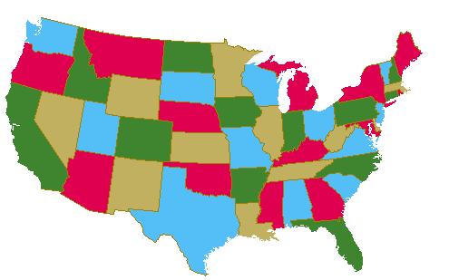
Map Coloring
Four colors are sufficient to color a map of the contiguous United States.
Source of map: http://www.math.gatech.edu/~thomas/FC/fourcolor.html

Slide 5
Dual Graph
Each map in a plane can be represented by a graph.
Each region is represented by a vertex.
Edges connect to vertices if the regions represented by these vertices have a common border.
Two regions that touch at only one point are not considered adjacent.
The resulting graph is called the dual graph of the map.

Slide 6
Dual Graph Examples
B
B
G
A
C
D
A
F
C
D
E
E
b
a d f g
e
b
a e
d
c
c

Slide 7
Graph Coloring
A coloring of a simple graph is the assignment of a color to each vertex of the graph so that no two adjacent vertices are assigned the same color.
The chromatic number of a graph is the least number of colors needed for a coloring of the graph.
What is the chromatic number of a bipartite graph?
Two

Slide 8
The Four Color Theorem
The chromatic number of a planar graph is no greater than four.
It was originally posed as a conjecture in the 1850s.
It was finally proved by two American mathematicians
Kenneth Apple and Wolfgang Haken in 1976.
This is the first mathematical theorem
that has been proven with help of computers.
They showed that if the theorem is false, there must be a counterexample
of one of approximately 2000 types.
They used computers to show that none of these counterexamples exists.

Slide 9
Example
What is the chromatic number of the graph shown below?
The chromatic number must be at least 3 since a, b, and c must be assigned different colors. So Let’s try 3 colors first. 3 colors work, so the chromatic number of this graph is 3.
b e
a d g
c f

Slide 10
Example
What is the chromatic number for each of the following graphs?
White
White
Yellow
Green
Yellow
Yellow
White
White
Yellow
Yellow
White
Chromatic number: 2 Chromatic number: 3

Slide 11
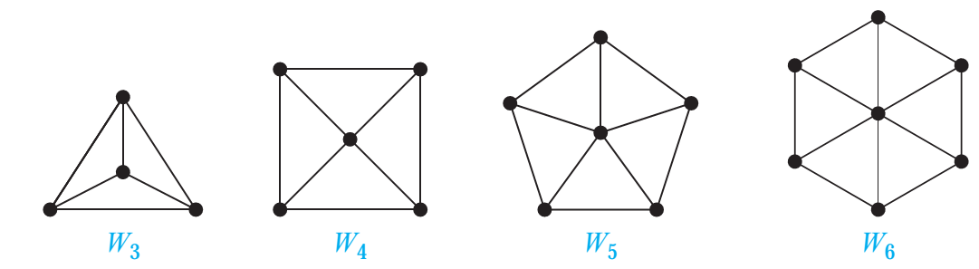
Example
What is the chromatic number of a wheel Wn?
3 if n is even, 4 if n is odd

Slide 12
Example
What is the chromatic number of Kn?
It is n. Hence non planar graphs (e.g., Kn for n>4) can have arbitrarily large chromatic number.

Slide 13
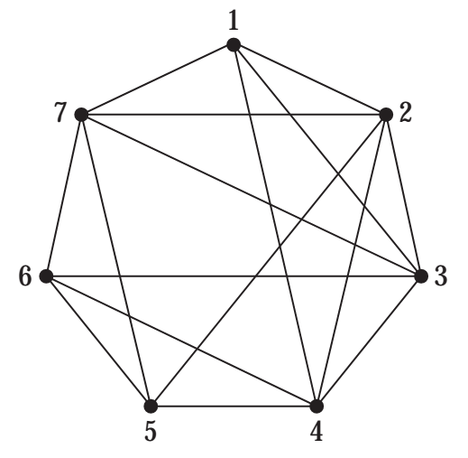
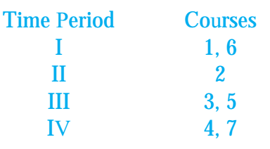
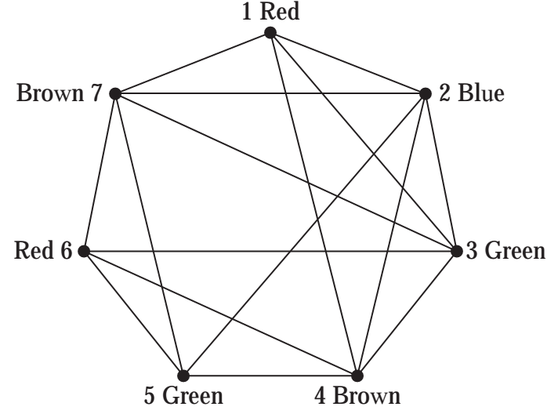
Applications
Graph coloring has a variety of applications to problems involving scheduling and assignments.
Scheduling Final Exams How can the final exams at a university be scheduled so that no student has two exams at the same time? Solution: This scheduling problem can be solved using a graph model, with vertices representing courses and with an edge between two vertices if there is a common student in the courses they represent. Each time slot for a final exam is represented by a different color. A scheduling of the exams corresponds to a coloring of the associated graph. For instance, suppose there are seven finals to be scheduled. Suppose the courses are numbered 1 through 7. Pairs of courses have common students is there is an edge:
Because the chromatic number of this graph is 4 four time slots are needed.

Slide 14
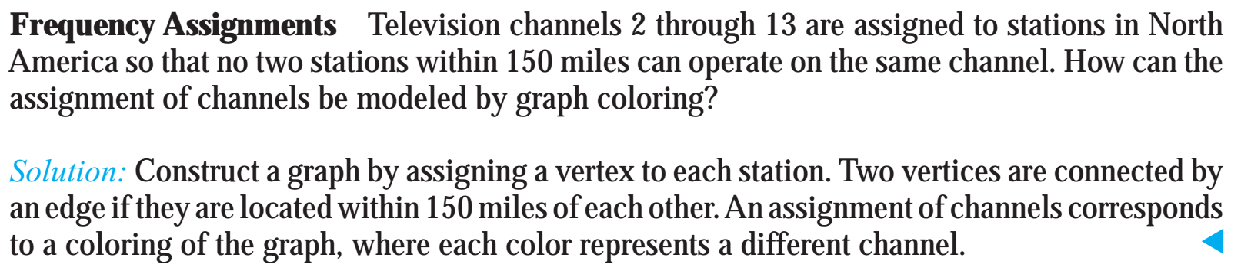
Applications

Slide 15
Time Complexity
The best algorithms known for finding the chromatic number of a graph have exponential
worst-case time complexity (in the number of vertices of the graph).
Even the problem of finding an approximation to the chromatic number of a graph is difficult.
This explains why scheduling final exams is so difficult, i.e., how can the final exams at a university be scheduled so that no student has two exams at the same time?

